Slide 1
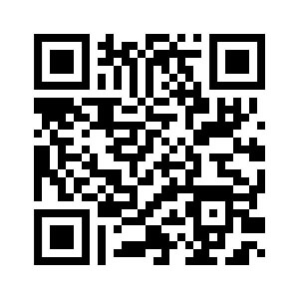
PowerShell Toolmaking Patterns and Practices
Unleashing the Power of Scripting Across Domains
Notes:
PowerShell, a versatile and powerful scripting language, has become essential for system administrators and automation enthusiasts. Once you master PowerShell scripting, you can harness its capabilities in various domains, providing limitless possibilities for automating tasks and managing complex systems. In this 45-minute session, we will explore the syntax and delve into the intangible elements that define a robust and efficient PowerShell tool.

Slide 2


Jeff Hicks
Jordan Benzing
PowerShell MVP | Author | Teacher
Microsoft MVP, Engineer
https://jdhitsolutions.github.io
https://jordantheitguy.com/

Slide 3

Expectations
This is not a session to teach you PowerShell scripting
Learn how to better apply what you already know
Identify gaps in your knowledge and experience
Answer your questions
Demos galore

Slide 4

Why Does This Matter?
PowerShell is a management engine
Interactive command console
Easy-to-learn scripting language
Learn once and apply everywhere
Recognize PowerShell’s limitations
Don’t force PowerShell to fit preconceptions

Slide 5

Understanding the PowerShell Paradigm
Everything is an object
PowerShell commands create and consume objects
Not Text
Output is sent via command pipeline
Objects in the pipeline can change
PowerShell displays objects at the end of the pipeline

Slide 6
Understanding the PowerShell Paradigm
$Path = "C:\Work"
Get-ChildItem -path $Path -Directory -PipelineVariable pv |
Foreach-Object {
Get-ChildItem -path $_ -file -Recurse |
Measure-Object -Property Length -sum |
Select-Object @{Name="Path";Expression = {$pv.Name}},Count,Sum
} | Sort-Object Sum -Descending |
ConvertTo-HTML -Title "Folder Report" -PreContent "<h1>Folder Report</h1><H2>Path: $path [$($env:ComputerName)]</H2>" -PostContent "<H5><I>Report Run $(Get-Date)</I></H5>" -Head "<style>$(Get-Content C:\scripts\sample3.css)</style>" |
Out-File c:\temp\report.html
PowerShell does not have to be written as one-line expressions

Slide 7
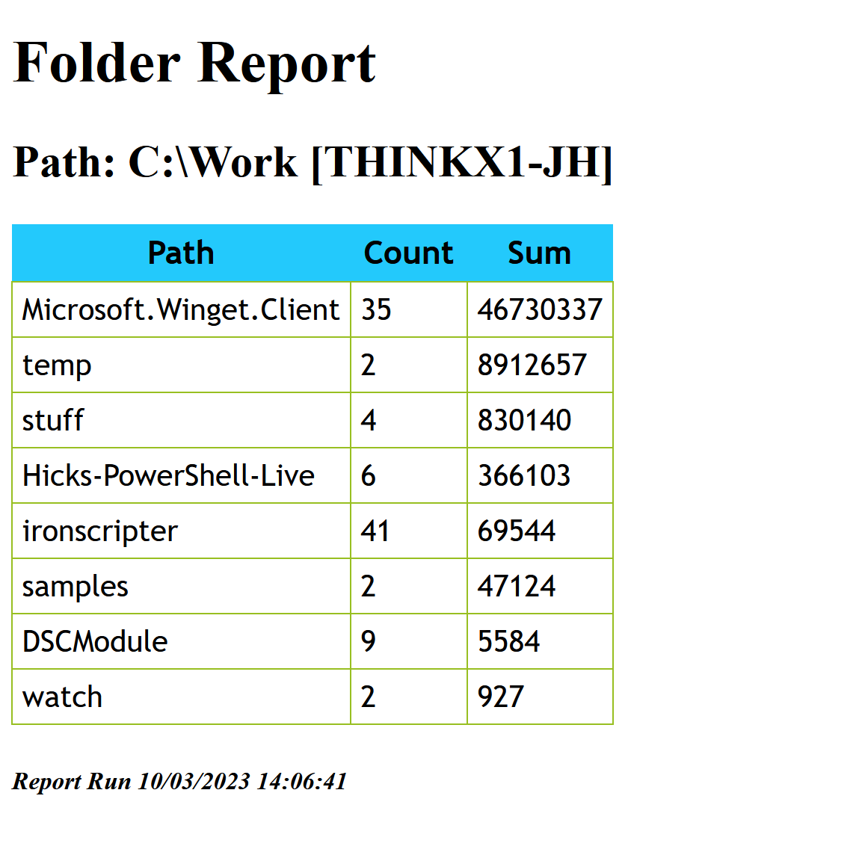
Understanding the PowerShell Paradigm

Slide 8

Language Elements
Variables
Hold temporary values
Arrays
Collections or groups of objects
Not required to be the same type
Hashtables
Name/Value pair
Dictionary object
Ordered option
Script blocks
Executable blocks of code
Can parameterize
Read the help!

Slide 9

Console to Script
Start with commands at the console
Create a basic script
Parameterize variables
Basic error handling
Create a simple function
Basic parameters
Refine to an advanced function
Pipeline input
Advanced parameters
Parameter sets
SupportsShouldProcess (-WhatIf)
Package related functions into a module

Slide 10

Toolmaking Design
Who will be using your tool?
What are their expectations?
How will they consume the output?
Assume nothing
Don’t force the user to do your work

Slide 11
PowerShell Patterns and Practices
Focus on techniques and concepts

Slide 12

Toolmaking Tips
Learn how to use the help system and use it often
Follow scripting best practices
Full cmdlet and parameter names
Follow naming standards and conventions
Code formatting matters
Document from the beginning
Separate formatting from output
Separate data from code
Script in layers
Test in a clean PowerShell environment
Learn Pester
powershell | pwsh –nologo -noprofile

Slide 13
https://github.com/jdhitsolutions/MMSMiami-2023

